Slide 1
Pragmatic JavaScript, jQuery, RIA, SignalR and More with ASP.NET v.Next
Jon Galloway
Microsoft
http://weblogs.asp.net/jgalloway
Notes:
Jscript Editor Extensions disabled
Visual Studio open

Slide 2
Tip 1: If you’re using Ajax Control Toolkit, get the newest releases
Notes:
First released in 2006 under MsPL, open for community contribution
http://stephenwalther.com/blog/archive/2011/09/27/september-2011-release-of-the-ajax-control-toolkit.aspx

Slide 3
Ajax Control Toolkit Releases
Date | Comment
10/2/2011 | Associated with Release: September 2011 Release.
10/2/2011 | Changed Calendar to use UTC time
9/11/2011 | Added Twitter control and sample page
9/11/2011 | Fixed regression with Calendar navigation images not appearing
8/31/2011 | Updated ReadMe and version info
8/31/2011 | Added Gravatar control and sample page
8/31/2011 | Fixed CodePlex issue 26770 concerning time zones
8/31/2011 | Implemented CodePlex feature request 15487 concerning highlighting today's date
8/31/2011 | Implemented feature 8109 concerning Calendar date ranges
8/11/2011 | Test and Fix for TabContainer scroll position in Chrome
8/2/2011 | Associated with Release: July 2011 Release.
8/2/2011 | Fixed Accordion Designer Issue
8/2/2011 | Fixed issue in Chinese resource file for Calendar today string
8/2/2011 | Added HtmlEditorExtender and SanitizerProviders
6/15/2011 | Fixed issue #26933 ToolkitScriptManager generating invalid HTML5
6/15/2011 | Adding Package bat files to automate release
5/8/2011 | Associated with Release: May 2011 Release.

Slide 4
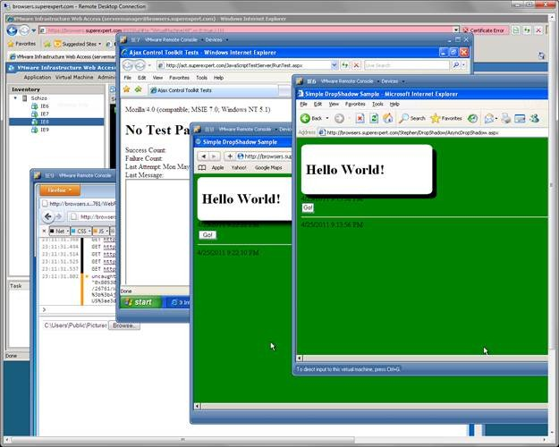
Automated testing (QUnit)

Slide 5
Demo
Installing ACT with NuGet

Slide 6
Tip 2: Get to know jQuery
DOM abstraction
Selector engine
Plugin ecosystem
Leverage CDN’s
Included in Microsoft templates
Notes:
DOM abstraction
Selection engine
Plugin ecosystem
Leverage CDN’s
Included in Microsoft templates

Slide 7
JavaScript is hard…
var myvar = 'my value';
(function() {
alert(myvar);
var myvar = 'local value';
})();
Notes:
DOM abstraction
Selection engine
Plugin ecosystem
Leverage CDN’s
Included in Microsoft templates

Slide 8
JavaScript is hard…
Let’s go shopping?
No
But, JavaScript can be hard
Unnecessary custom code is a liability
Notes:
DOM abstraction
Selection engine
Plugin ecosystem
Leverage CDN’s
Included in Microsoft templates

Slide 9
Tip 3: Install and Update jQuery via NuGet
Demo jQuery Plugins, too

Slide 10
Tip 4: Know how to find and use jQuery plugins
NuGet
http://plugins.jquery.com
jQueryUI
Demo Datepicker
Notes:
plugins.jquery.com
Jqueryui.com
NuGet

Slide 11
Tip 5: Use jQuery UI via Unobtrusive Wire-up
Demo unobtrusive.jquery.ui

Slide 12
Tip 6: Write your own jQuery plugins
Demo jQuery Snippets

Slide 13
Tip 7: Take advantage of Visual Studio’s JavaScript support
Notes:
Intellisense
for (var i = 0; i < 20000000000000000; i++) {
if (i % 2) {
window["foo" + i] = i;
} else {
window["foo" + i] = "fooooo";
}
}

Slide 14
Tip 8: Get ready for Visual Studio 11 JavaScript features
http://bit.ly/vs11javascript
Implicit and customizable references
Notes:
http://blogs.msdn.com/b/webdevtools/archive/2011/09/15/new-javascript-editing-features-for-web-development-in-visual-studio-11-developer-preview.aspx

Slide 15
Tip 9: Use the Visual Studio 2010 JScript Editor Extensions
http://visualstudiogallery.msdn.microsoft.com
Brace Matching
Outlining / Code Folding
Current Word Highlighting
IntelliSense Doc-Comments <para> support

Slide 16
Tip 10: Use ASP.NET 4 ScriptManager features
Notes:
jQueryWebforms

Slide 17
Tip 12: Use RIA/JS for WCF services

Slide 18
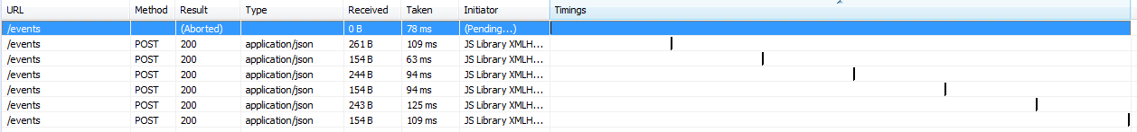
Tip 13: Use SignalR for long-polling
The old way: Polling
Notes:
Explain
Shape sharing demo
http://chatapp.apphb.com

Slide 19
Tip 13: Use SignalR for long-polling
The new way: long-polling
Notes:
Explain
Shape sharing demo
http://chatapp.apphb.com

Slide 20
Tip 14: Server-side JavaScript with iisnode and Node.js
Demo (WebMatrix)

Slide 21
Tip 15: Adventurous? Keep an eye on CoffeeScript

Slide 22
Your Feedback is Important
Please fill out a session evaluation form drop it off at the conference registration desk.
Thank you!

